Slide 1



Text to Speech Web Extension
Nupur Khatri
Jaahanava Joshi
Hasti Sutaria
Bhakti Chokshi
Bhavya Adhiya

Slide 2


Index
1)Introduction
2)Main Project Ideation
3)Workflow Diagram
4)Data Flow Diagram
5)Use Case Diagram
6)Features of TTS Extension
7)Conclusion
8)References

Slide 3

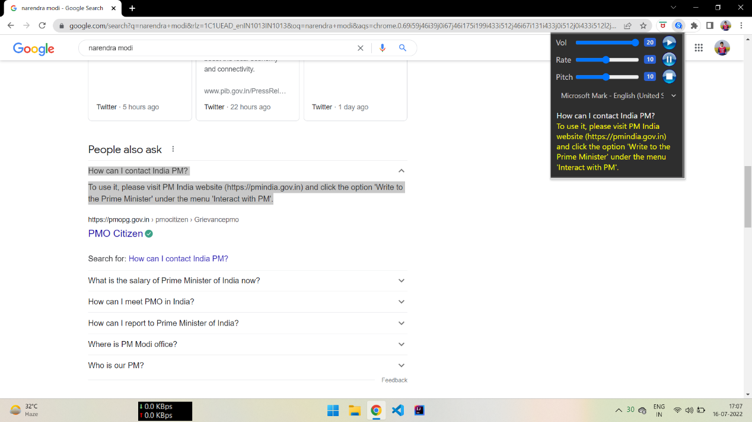
Introduction
Text-to-Speech (TTS) is a useful technology that converts any text into a speech signal. It can be utilized for various purposes, e.g. car navigation, announcements in railway stations, response services in telecommunications, and e-mail reading.

Slide 4

Main Project Idea
Our Idea was to bring text to speech converter available on the browser with just one click.
So we decided to make a Text to Speech web extension as who loves to read when we can hear it!
This Photo by Unknown author is licensed under CC BY.

Slide 5

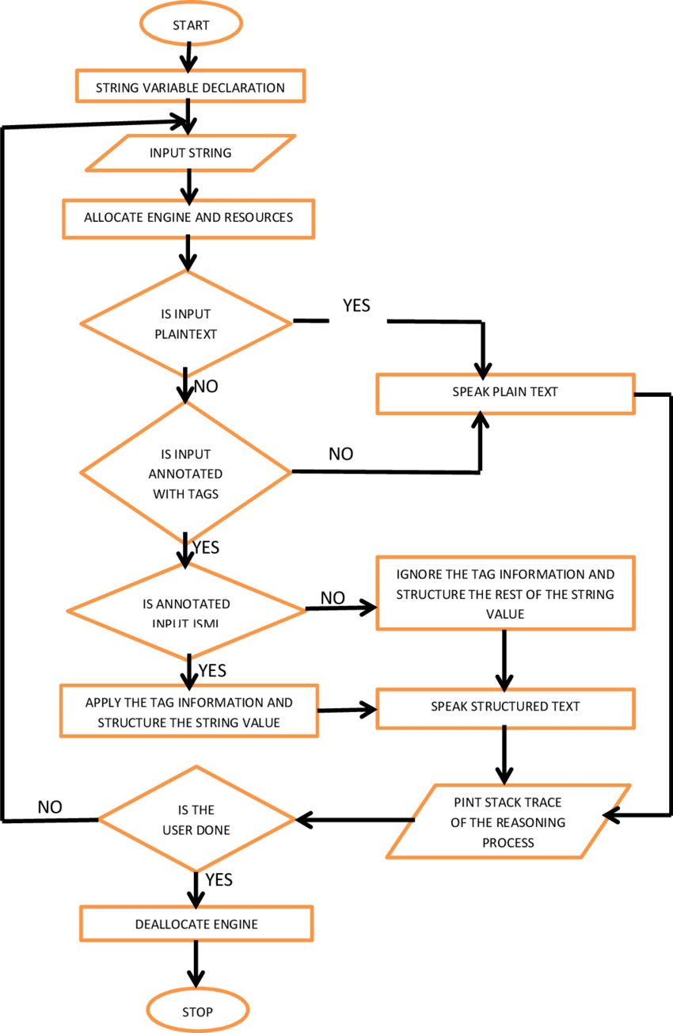
Work Flow Diagram

Slide 6
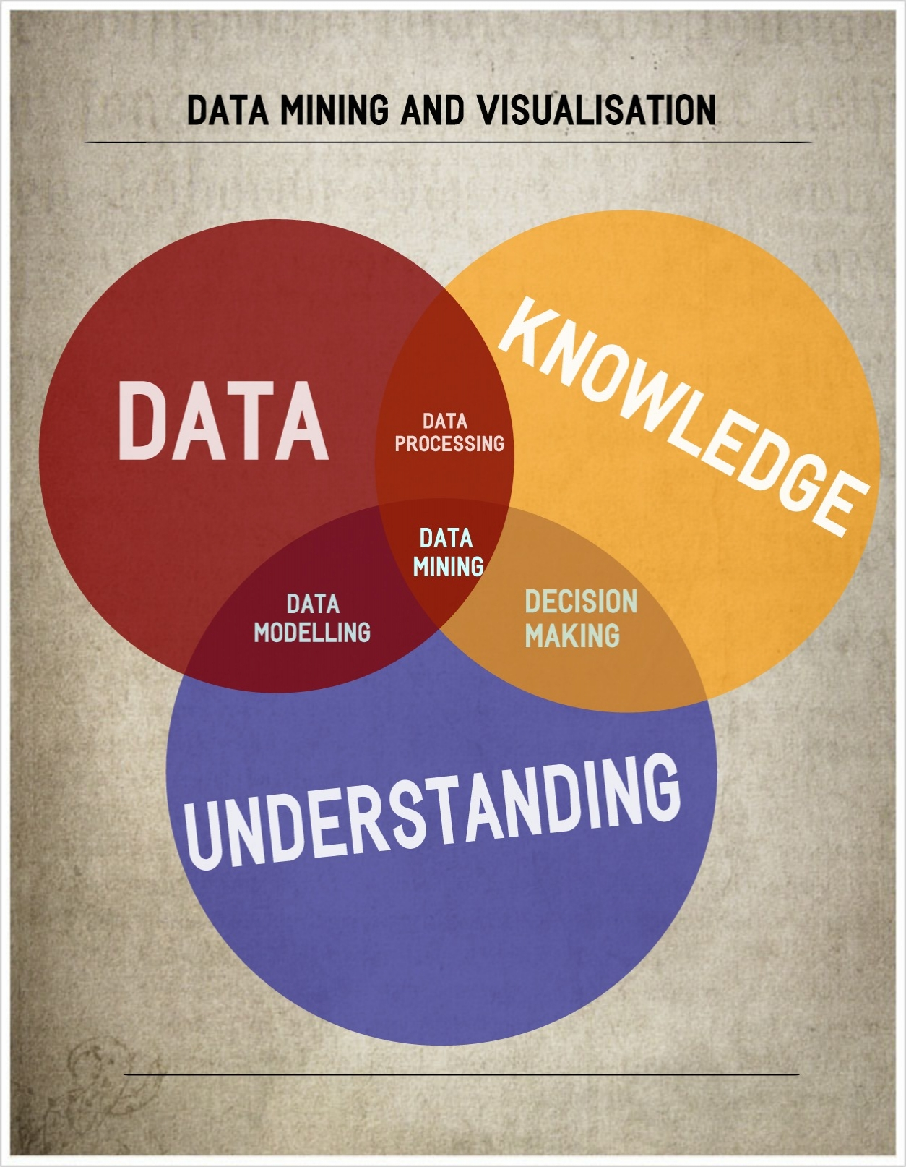
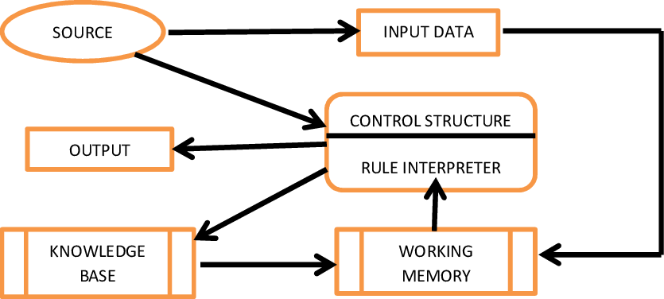
Data Flow Diagram
This Photo by Unknown author is licensed under CC BY-NC.

Slide 7
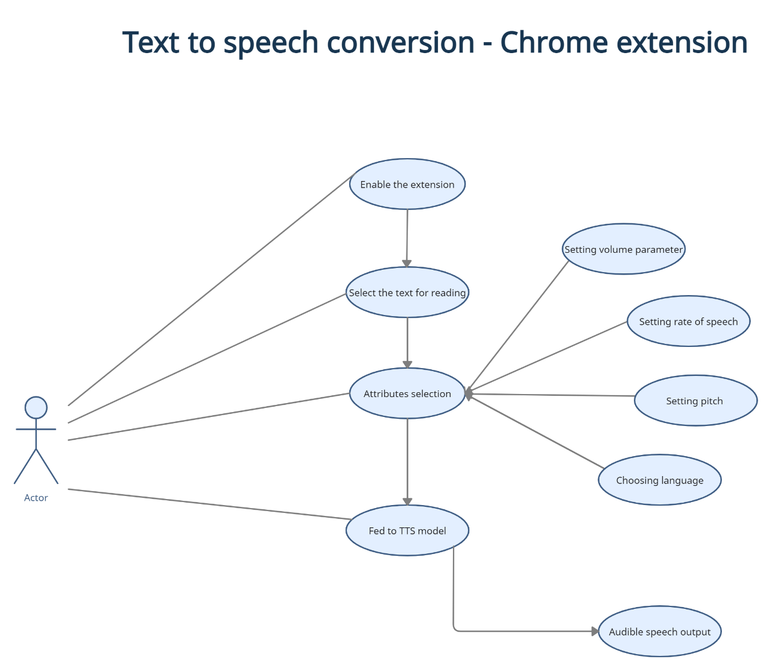

Use Case Diagram

Slide 8
Features of TTS Extension
User-friendly
Widget with customizable options
Has Multiple language and voice options to choose from
Speech conversion of selected text
Text Highlighting
Playback Controls
Voices sound better than the competition
Chrome versions available
Immersive Reader
No registration required for usage

Slide 9

Conclusion
We were able to develop an extension as per our goal in which the user is able to listen to the text rather than read it. It has covered all the cases and has been tested rigorously. Our main focus was to make this user-friendly and we can say that we have achieved this. The user just needs to install our extension and he can start using it and decide when to listen when to pause it (whenever required) and stop it.

Slide 10

References
https://docs.microsoft.com/en-us/learn/modules/intro-to-text-to-speech/
https://support.google.com/chrome/a/answer/2714278?hl=en
https://www.readingrockets.org/article/text-speech-technology-what-it-and-how-it-works
https://www.sitepoint.com/create-chrome-extension-10-minutes-flat/
This Photo by Unknown author is licensed under CC BY-SA-NC.

Slide 11

Thank You

